Slide 1
Church Management system (CMS)
Elk Creek Baptist Church
November 15, 2025

Slide 2
Basic requirement
Find a software package that will help us efficiently manage church functions and enhance communications while also reducing the workload on key volunteer staff.

Slide 3
Our process
Exploratory search for candidate systems – July 2024
Developed requirements – August to September 2024
Prioritizing requirements – October 2024
Narrowed down selections (6) based on the requirements – November 2024
Shared initial findings and Demonstration to Communications Committee – January 2025
Beta-Testing – March to September 2025
Presentation to Admin Council – October 2025
Decision to Proceed – November 2025

Slide 4

Candidate systems (for Medium-sized churches *)
ChMeetings – rated 4.8 out of 5.0
ChurchTrac – rated 4.8
TouchPoint – rated 4.3
FlockBase – rated 4.7
Planning Center – rated 4.7
Breeze ChMS – rated 4.8
* Up to 500 members

Slide 5
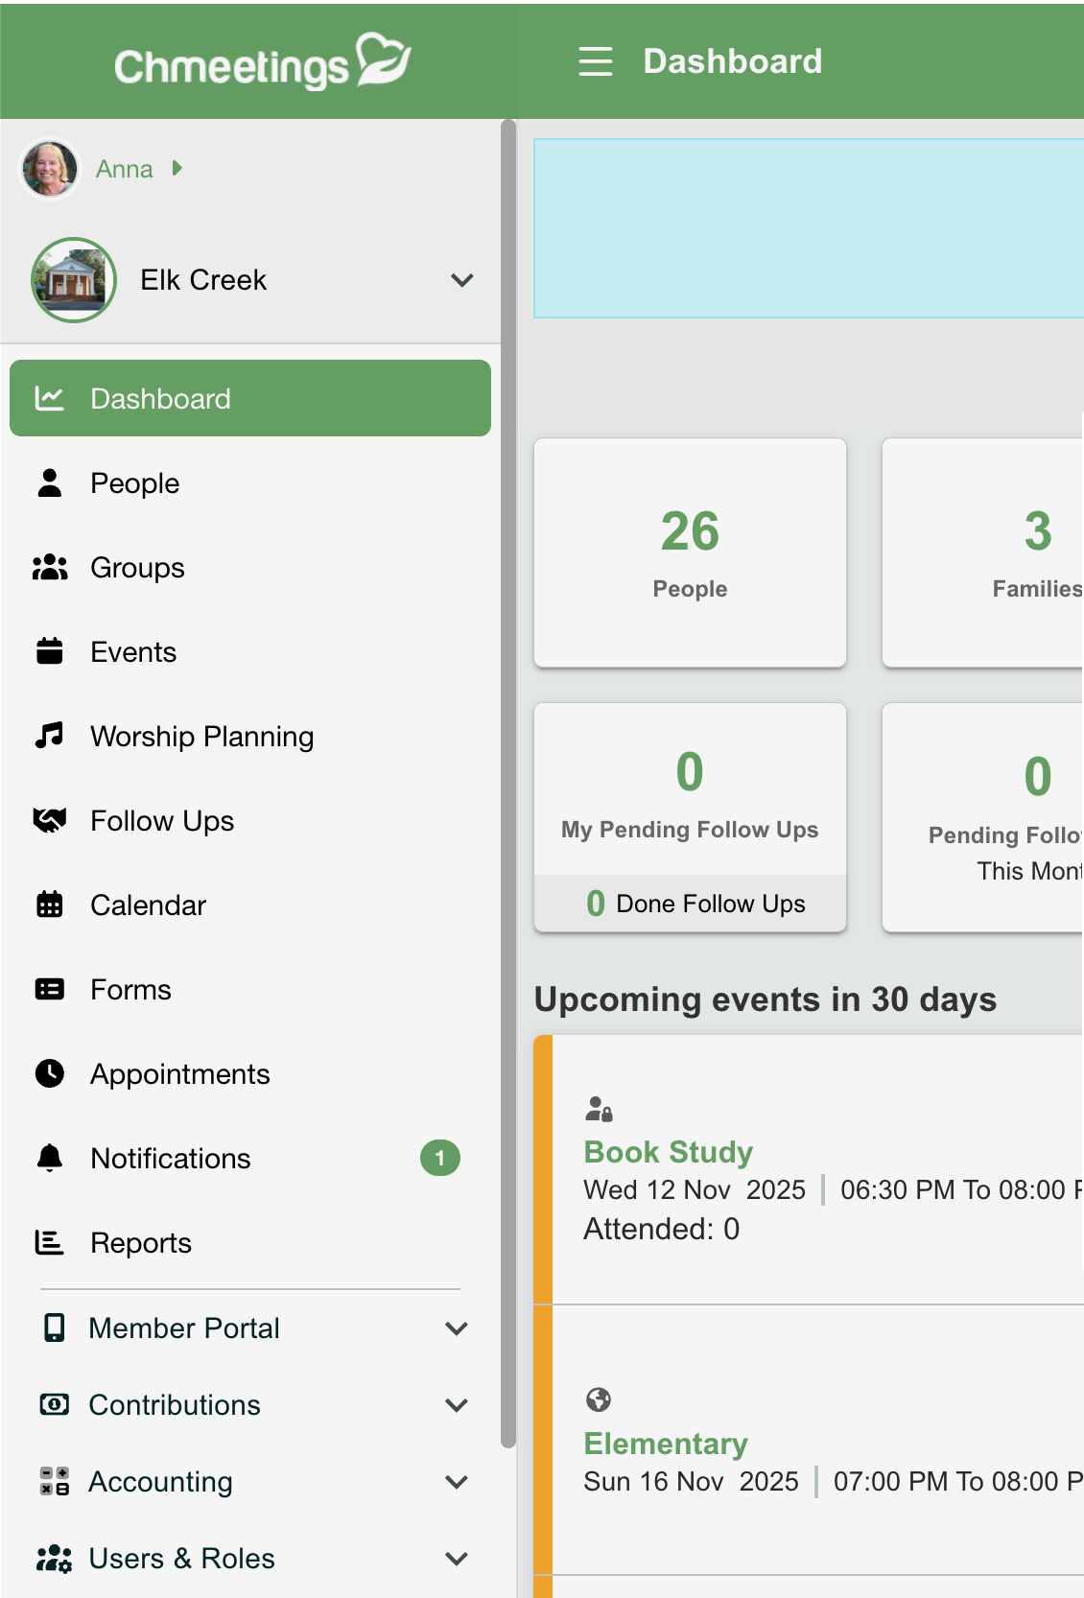
FEATURES
People Management
Send Emails & Texts
Event Registration & Payment
Member Portal
Mobile App
Calendar
Volunteer Scheduling
Appointments
Worship Planning
Online Giving & Pledges
Accounting Module (Included)
$40 per month or $400 per year
* Tech Support included

Slide 6
Questions

